Slide 1
Day 3

Slide 2
Data Source File
https://drive.google.com/drive/folders/1xcmHEYOB0clh54Y4-3EqEd0Fz8X8KYDk

Slide 3
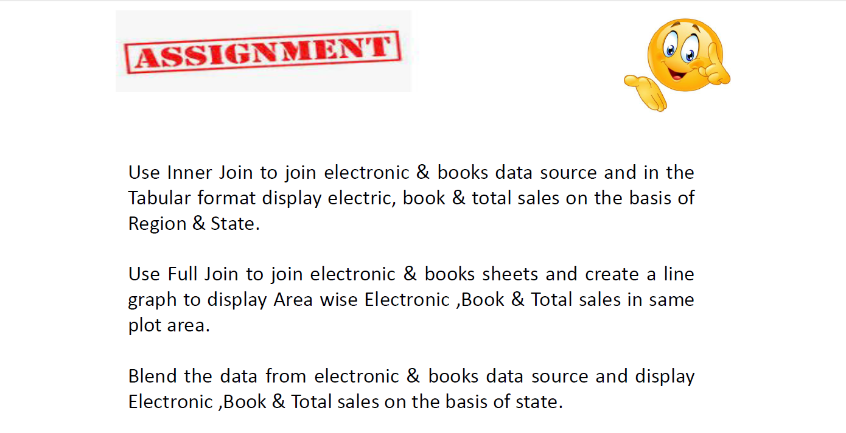
Questions:

Slide 4
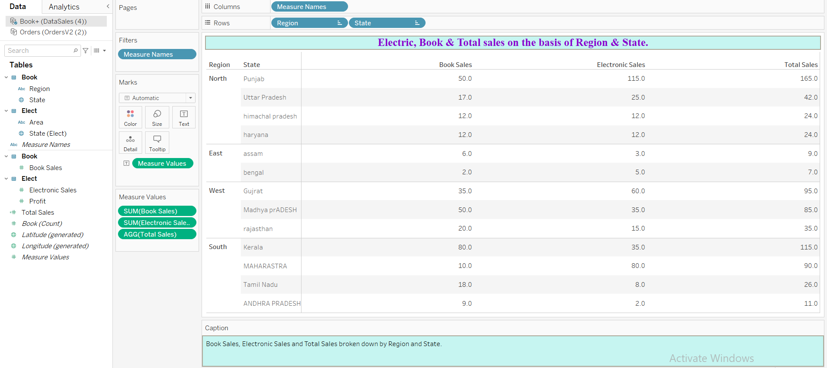
Electric, Book & Total sales on the basis of Region & State.

Slide 5
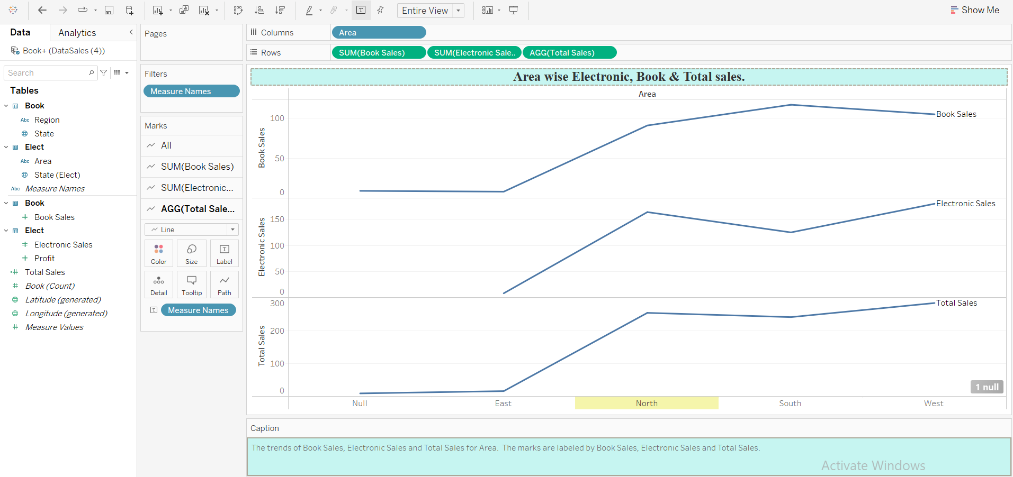
Area wise Electronic, Book & Total sales.

Slide 6
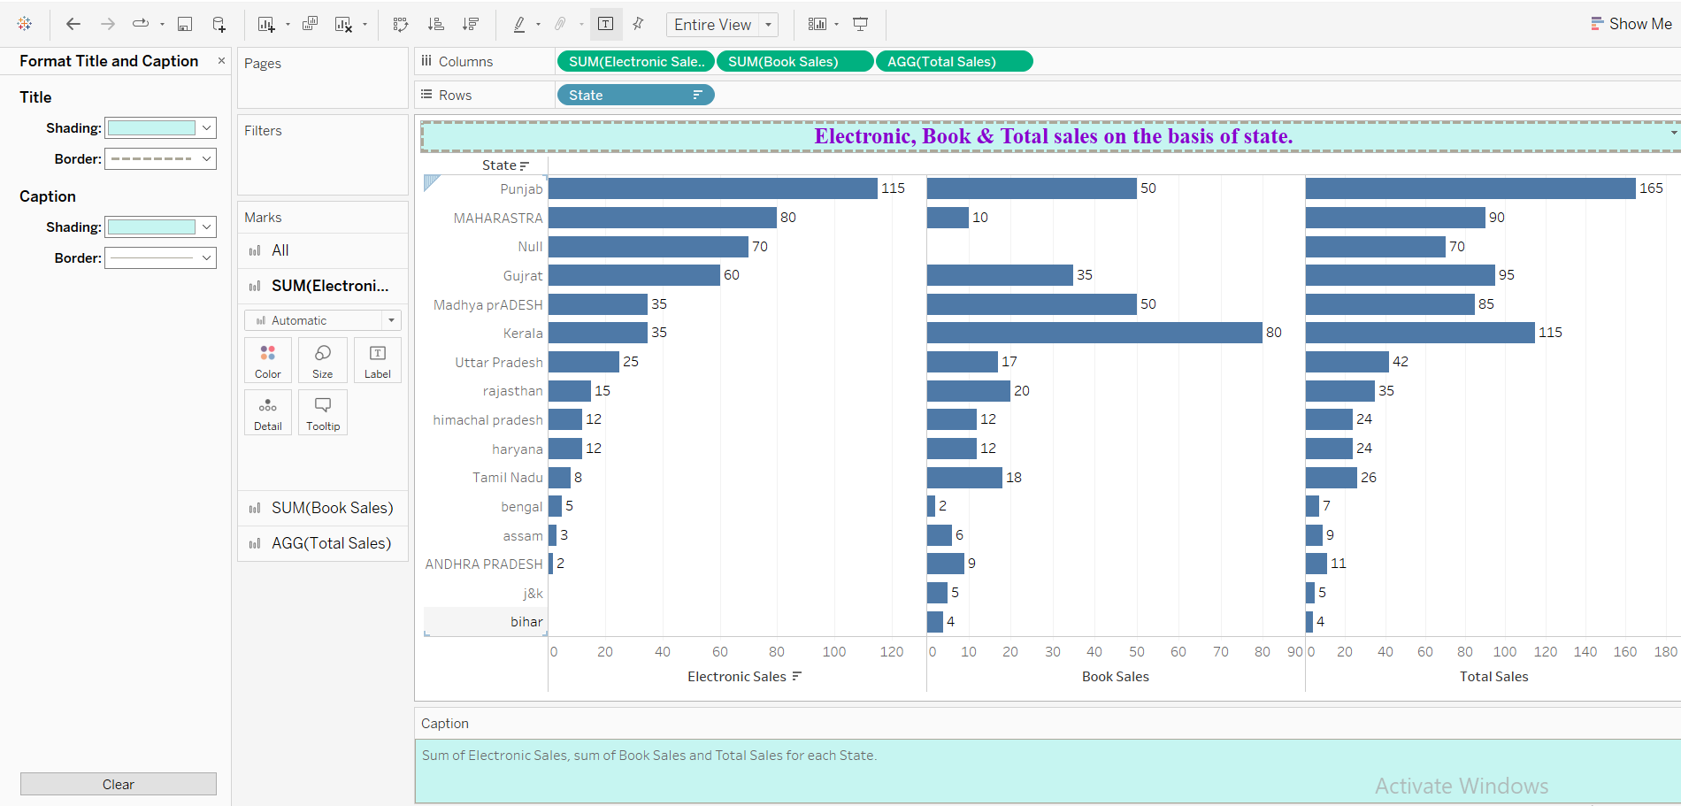
Electronic, Book & Total sales on the basis of state.

Slide 7
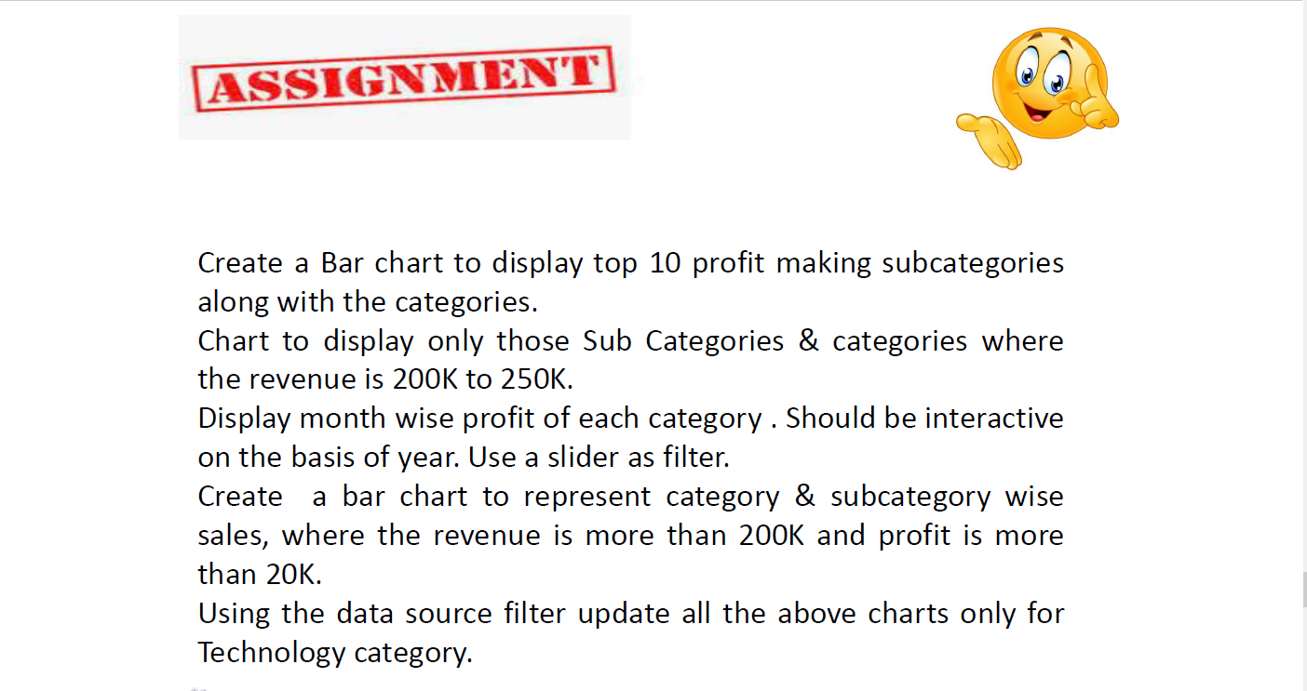
Questions:

Slide 8
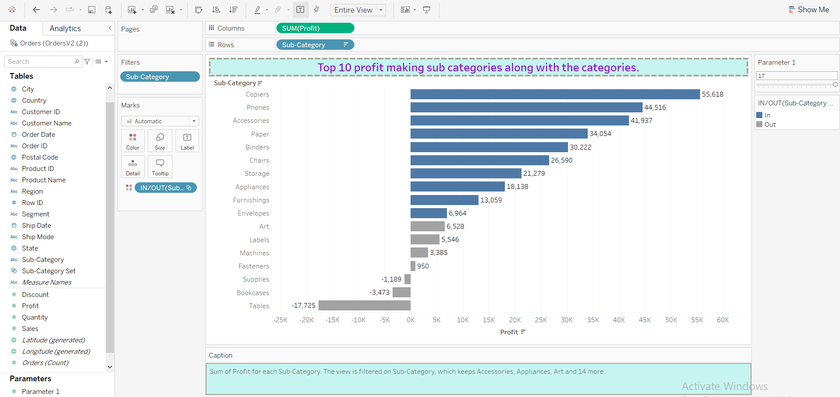
Top 10 profit making sub categories along with the categories.

Slide 9
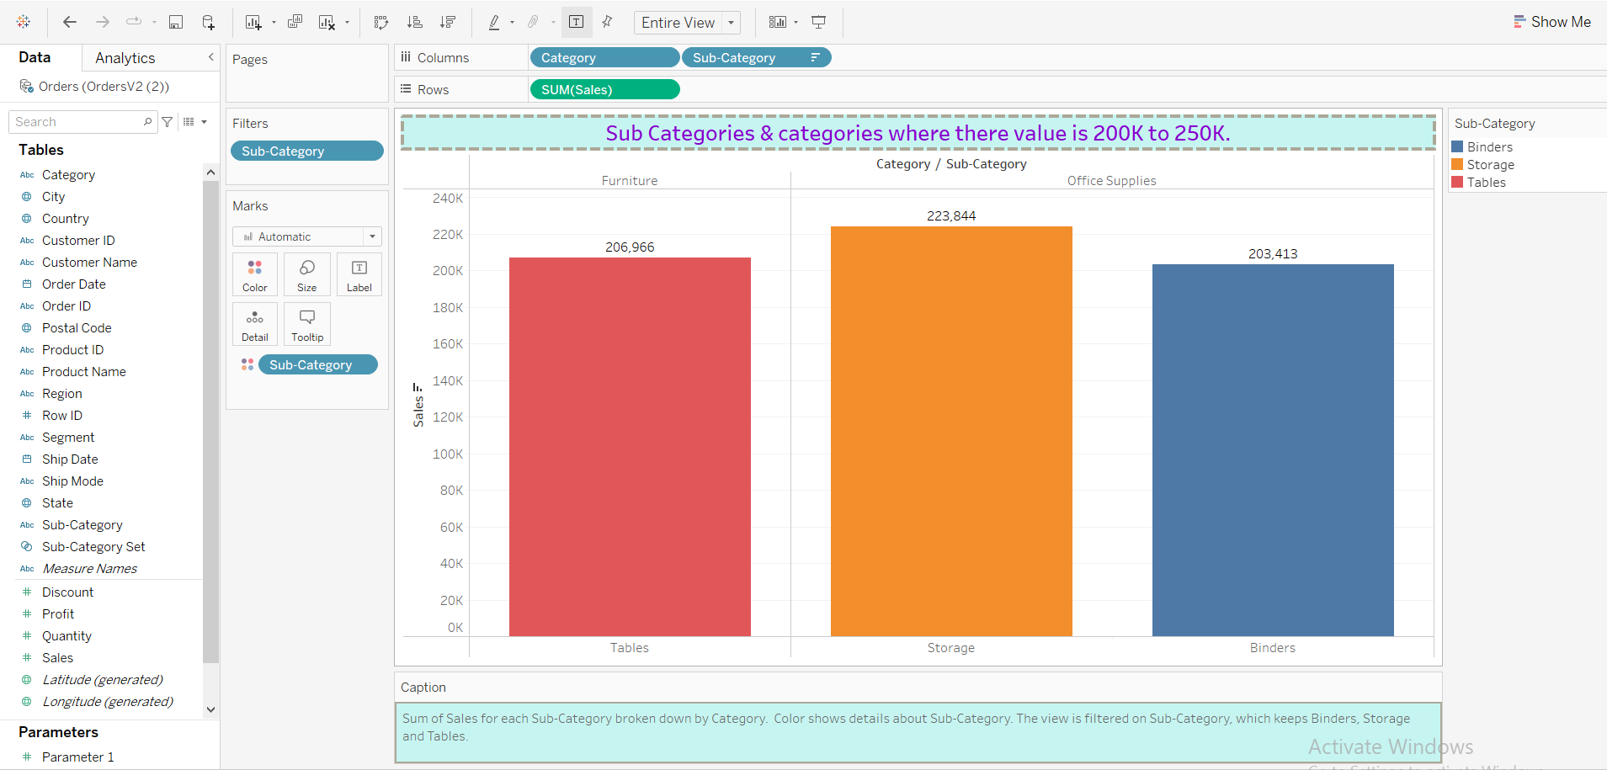
Sub Categories & categories where there value is 200K to 250K.

Slide 10
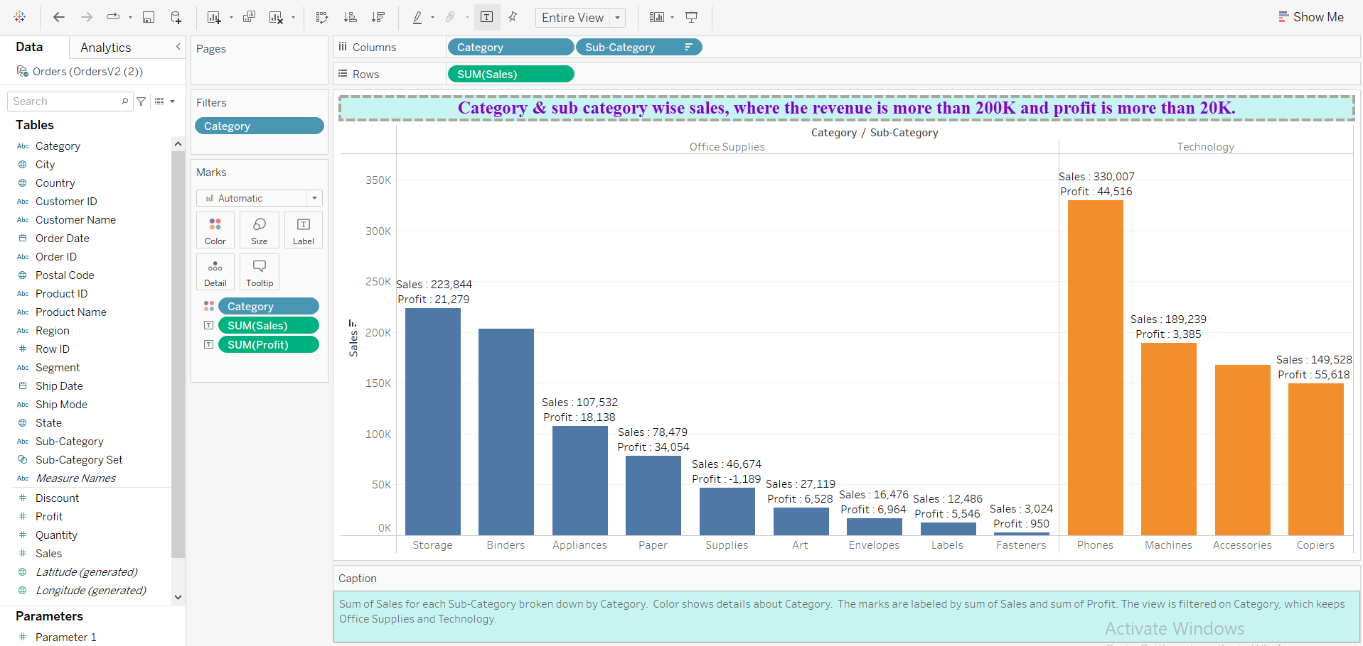
Category & sub category wise sales, where the revenue is more than 200K and profit is more than 20K.

Slide 11
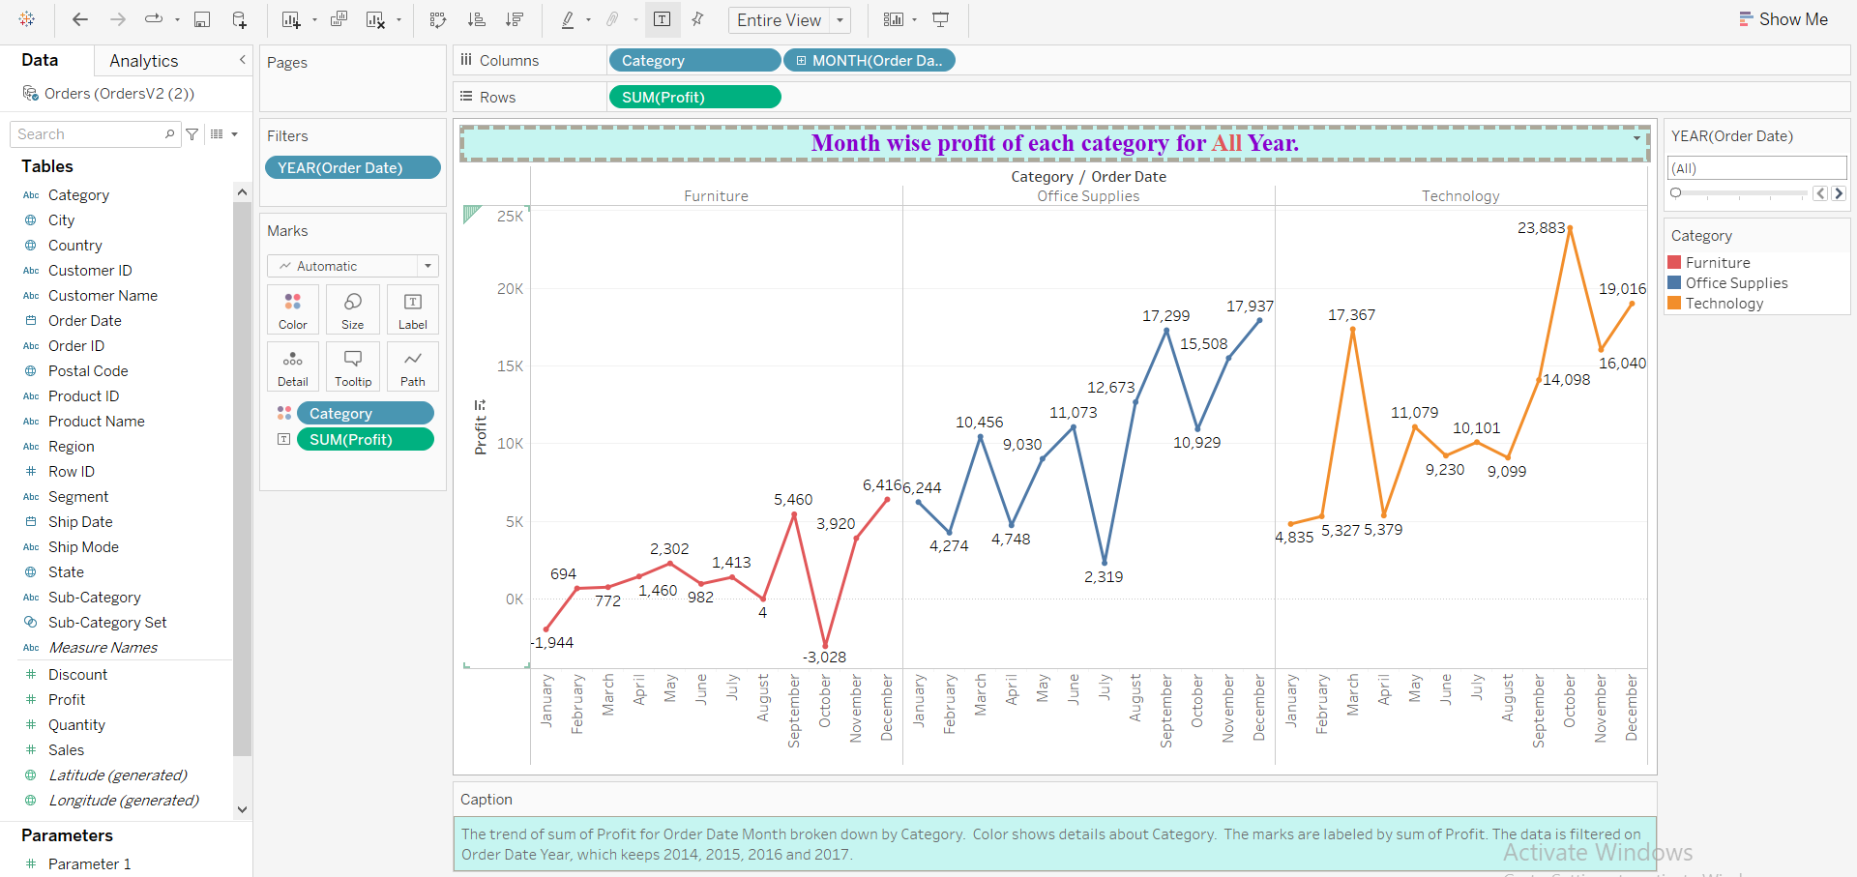
Month wise profit of each category All Years.

Slide 12
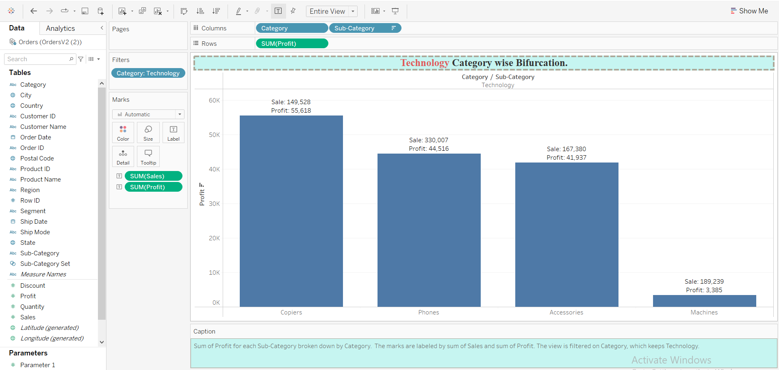
Technology Category wise Bifurcation.

